Slide 1
Vectorization
Parallel Programming Lab2-3
Oct 20 2022

Slide 2
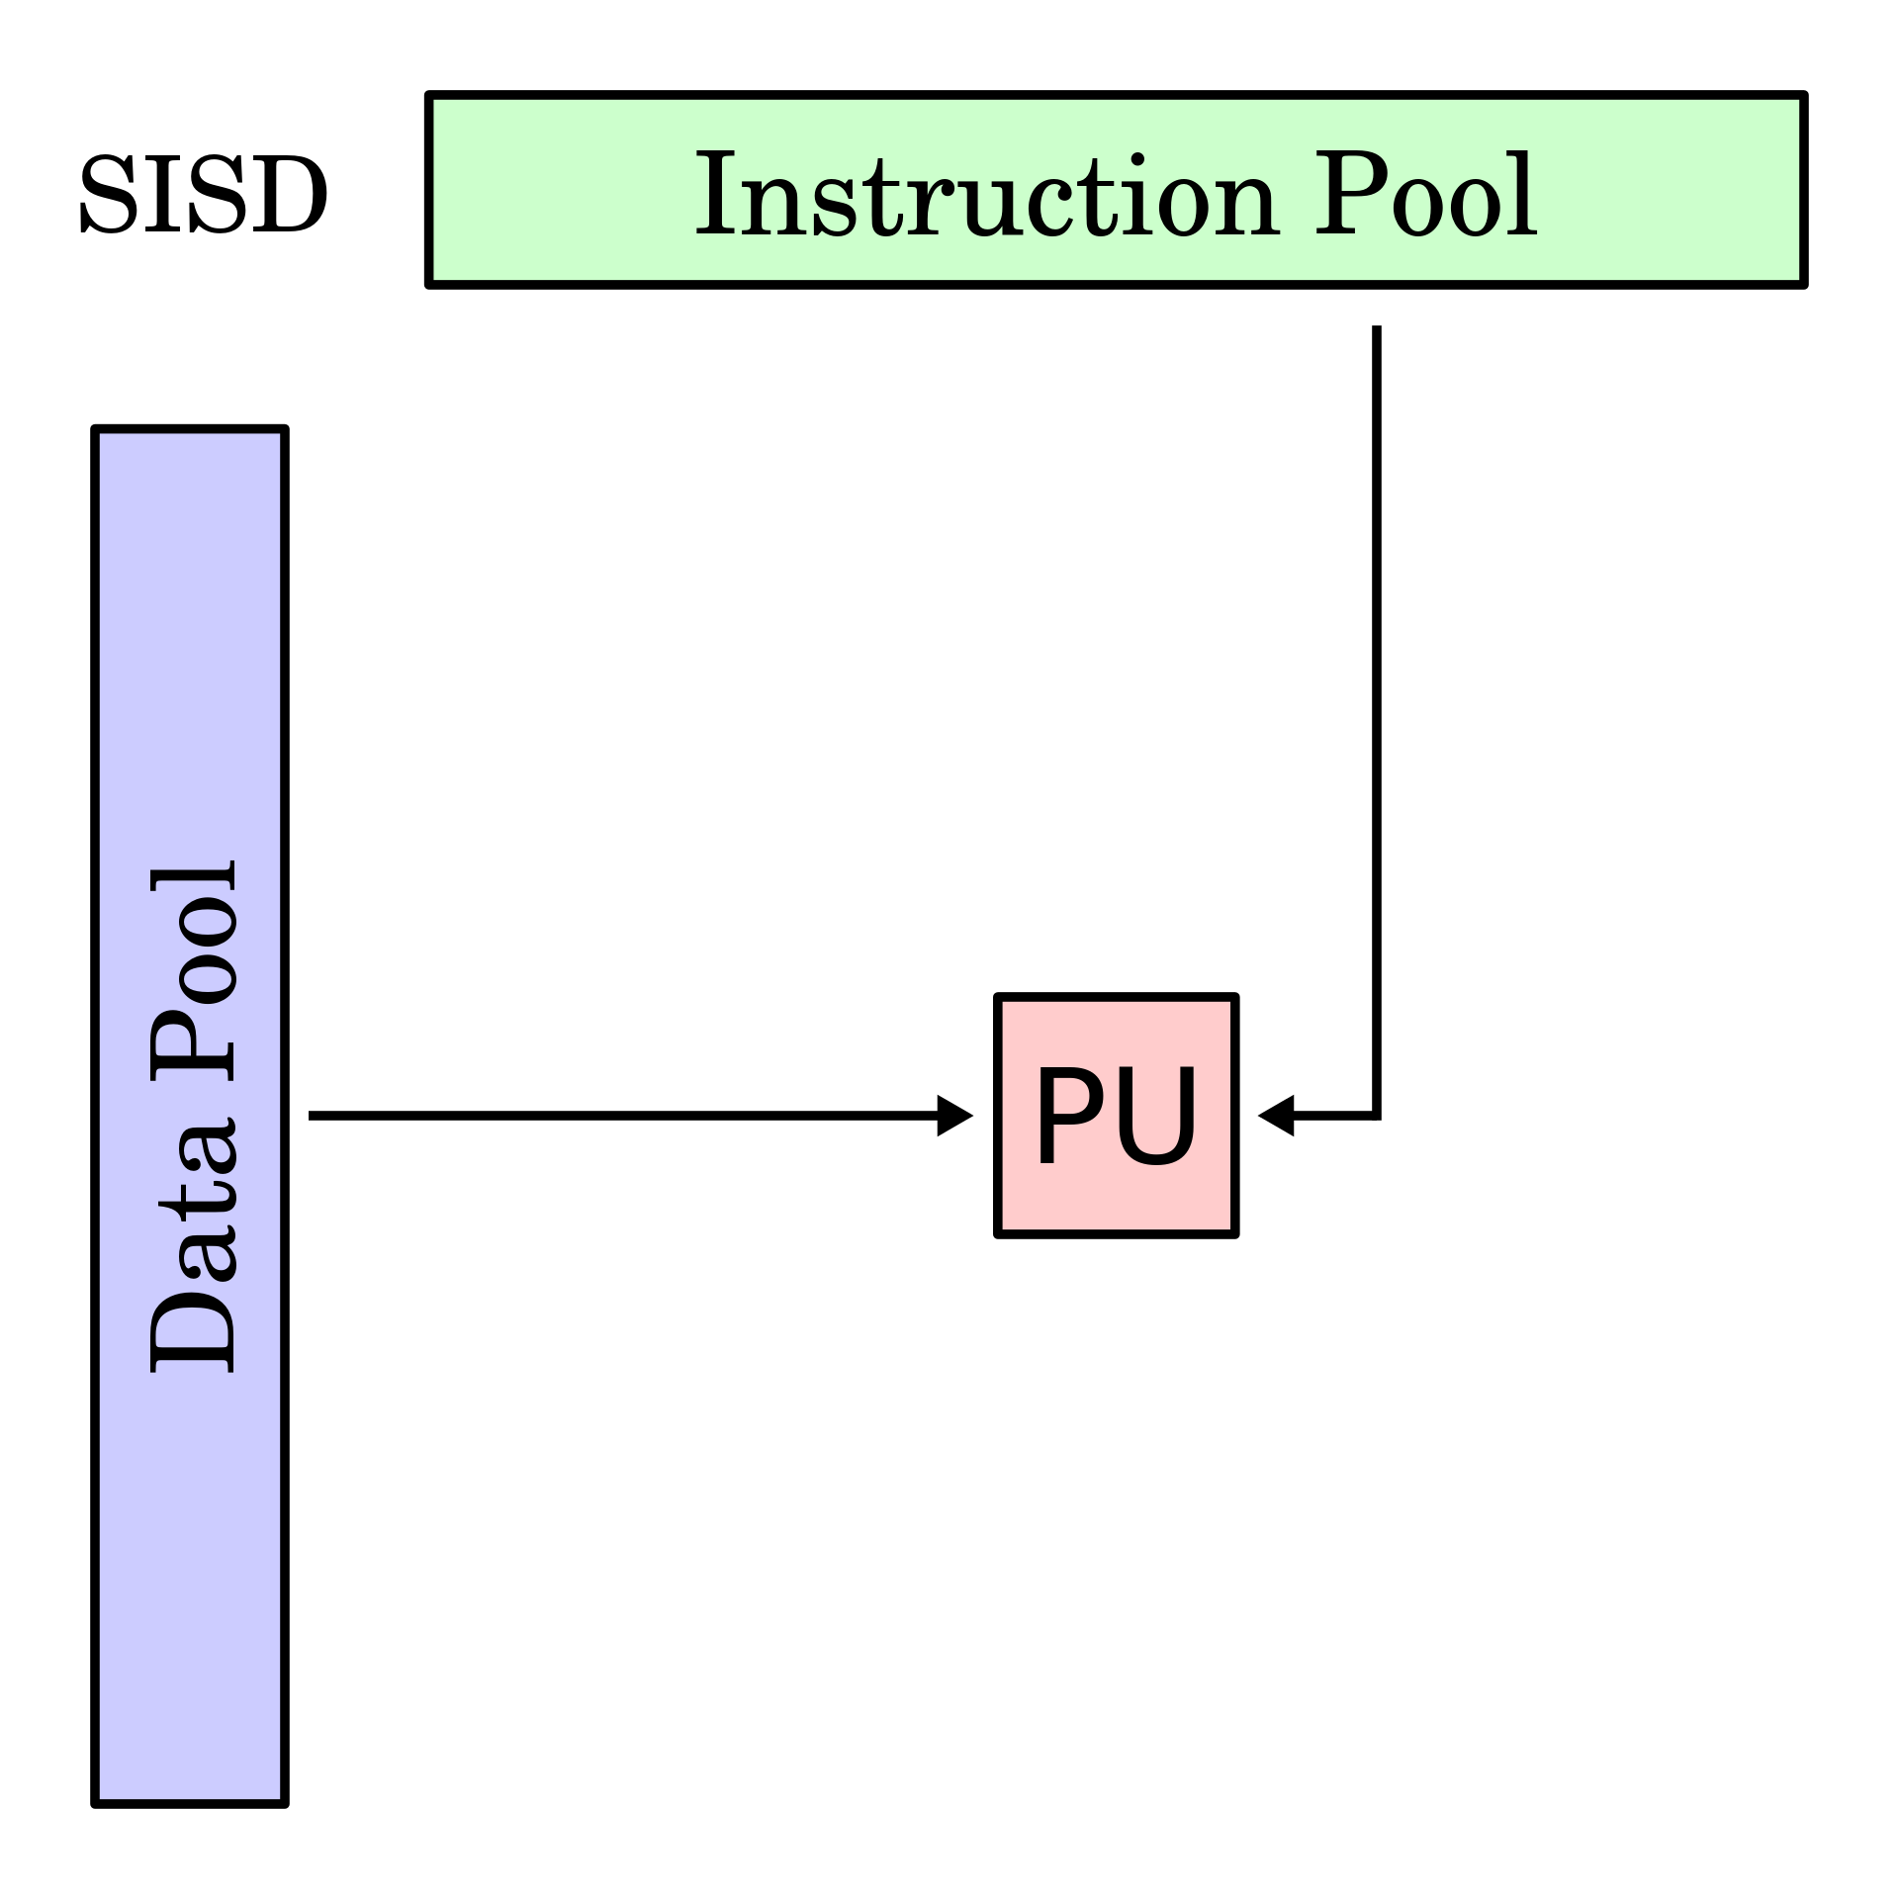
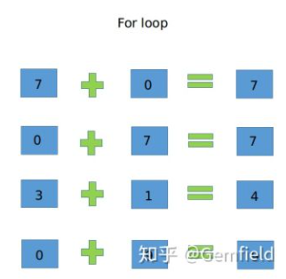
How CPU Execute an Instruction

Slide 3
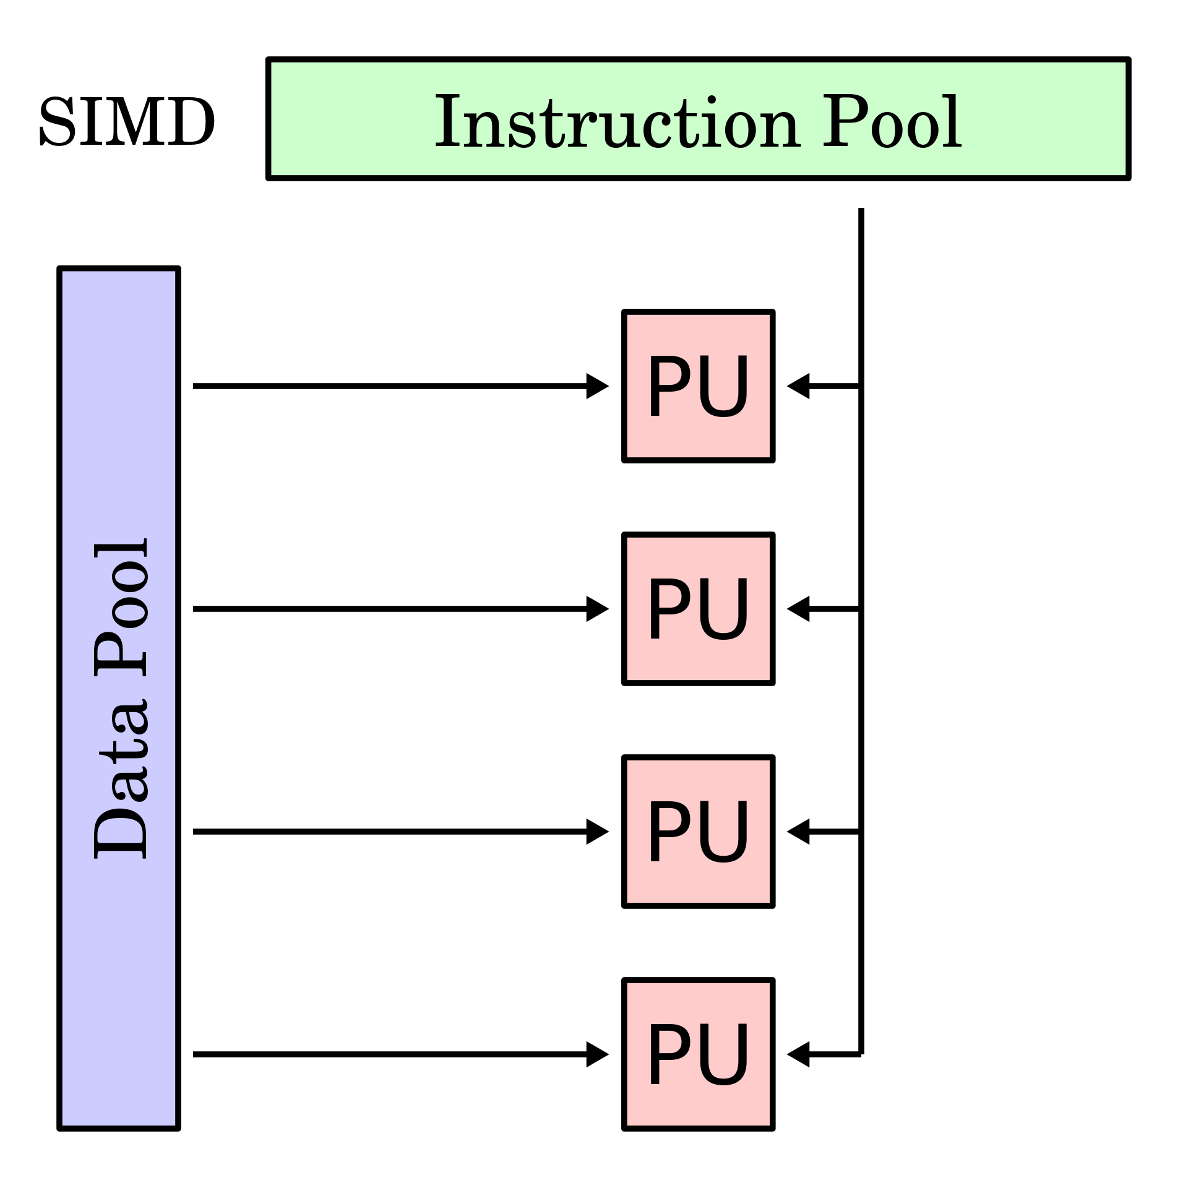
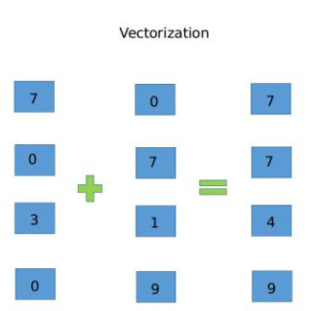
How CPU Execute an Instruction

Slide 4
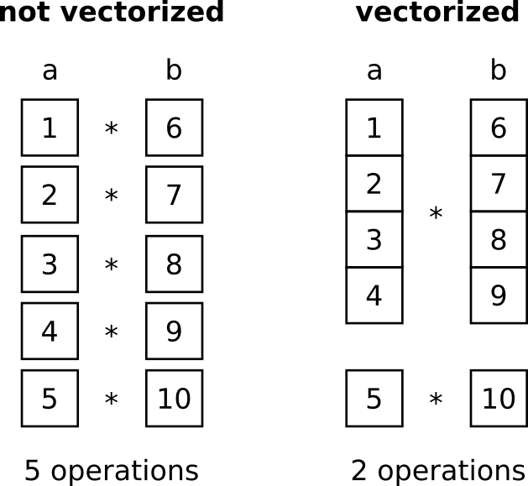
Vector Instruction Set
Instructions that design to operate on vectors.

Slide 5
When to use Vector Instruction Set?
A part of codes that are executed many times
In a loop
There are no data dependency between each iteration
Data dependency:
In iteration i, it needs the result of iteration i-1 to calculate its result

Slide 6
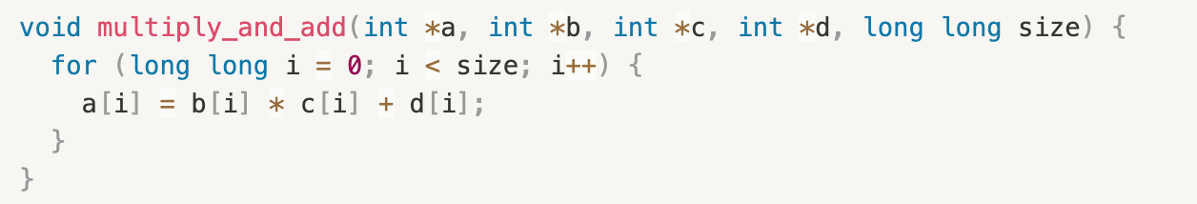
When to use Vector Instruction Set?
Vectorizable
Some observations
In each iteration, the result of a[i] is independent with each other
The same instructions are executed many times on different data

Slide 7
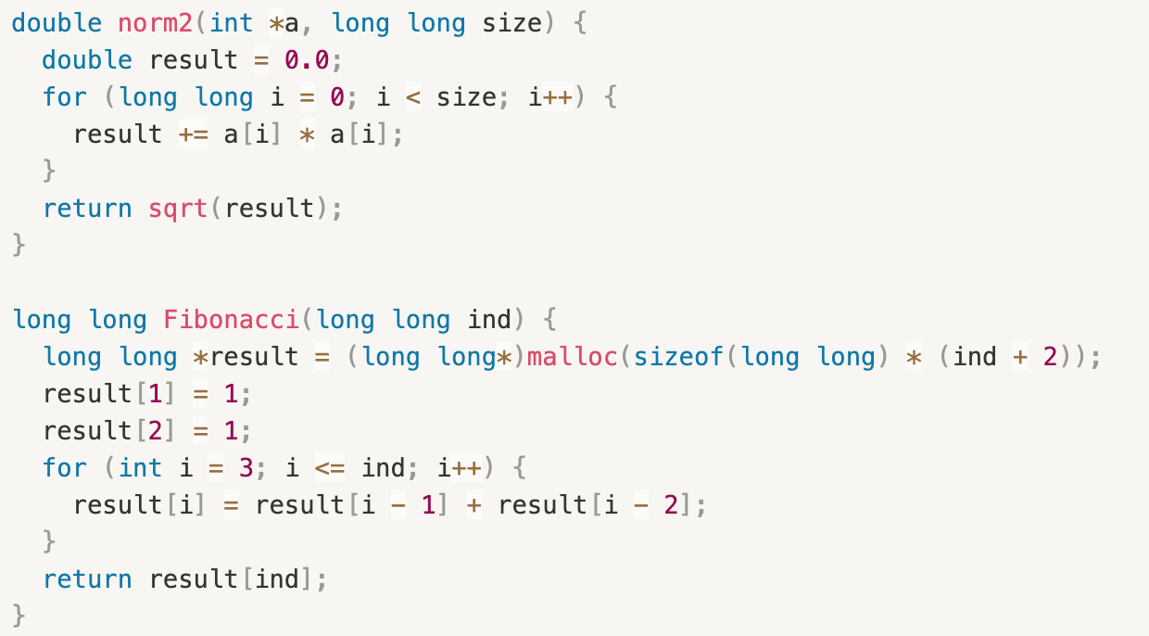
When to use Vector Instruction Set?
Non-vectorizable

Slide 8
Vector Instruction Sets
MMX (64-bit)
SSE (64~128-bit)
FMA (128~256-bit)
AVX (128~512-bit)

Slide 9
Vector Instruction Sets
MMX
SSE
Streaming SIMD Extensions
Versions: SSE, SSE2, SSE3, SSSE3, SSE4.1, SSE4.2
Calculate 128-bit data in an instruction (include integer & floating point)
8x 16-bit short ⇐ 8x faster
4x 32-bit integer ⇐ 4x faster
4x 32-bit floating-point number ⇐ 4x faster
2x 64-bit double-precision number ⇐ 2x faster

Slide 10
Vector Instruction Sets
SSE
16 registers (XMM00~XMM15)
SSE: only 32-bit floating point
SSE2: double, long long, int, char
Newer SSE only adds more kinds of instruction

Slide 11
Vector Instruction Sets
FMA
Fused Multiply–Add
a = b * c + d
Versions: FMA4, FMA3
128-bit and 256-bit of FMA operations
FMA4:
4-operand instructions, only supported by AMD CPU
FMA3:
3-operand instructions (a could only be b, c, or d) Ex: b = b * c + d

Slide 12
Vector Instruction Sets
AVX
Advanced Vector eXtensions
More bits: More data could be calculated at a time
More registers: More complex calculation is supported
Version | AVX, AVX2(extension of AVX) | AVX512
Width | 256-bit vector instructions | 512-bit vector instructions
Register | 16 (YMM00~YMM15) | 32 (ZMM00~ZMM31)

Slide 13
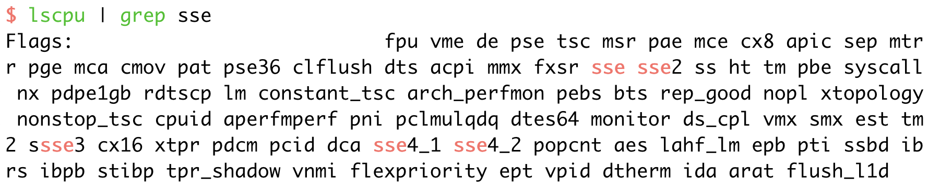
Check Hardware Support
Linux command: lscpu | grep -i $instruction_set
where $instruction_set could be mmx, sse, sse2, sse3, ssse3, sse4_1, sse4_2, avx, avx2, avx512
Most CPUs released after 2011 support AVX instructions

Slide 14
Automatic Vectorization
GCC
Vectorization is enabled by the flag -ftree-vectorize
Enabled by default with flag -O3
Add flag -march=native to use instructions supported by the local CPU
Add compiler flag -fopt-info-vec-all to see vectorization log
Add #pragma GCC ivdep to code to declare that there is no data dependency in the following loop

Slide 15
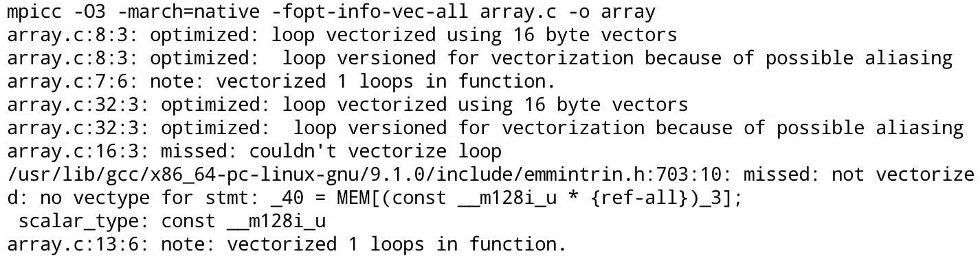
Automatic Vectorization
See more: link
LLVM Compiler: link

Slide 16
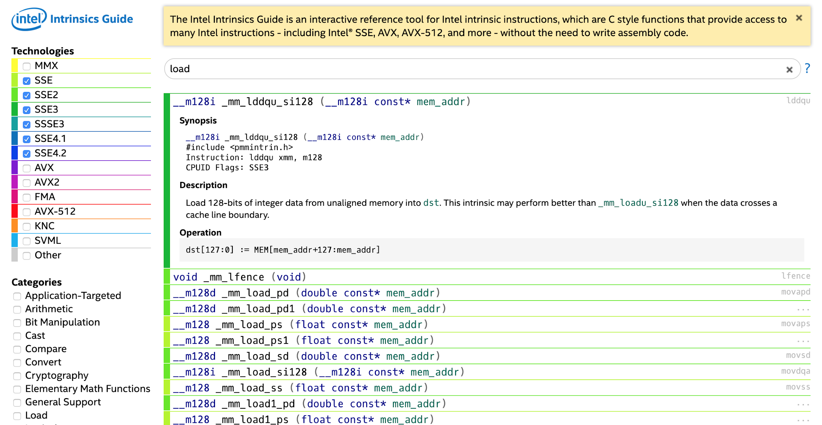
Vectorize Loop with Intel Intrinsics
Intel Intrinsics Guide: link
Check the instruction set you want to use
Use keyword to search
Check the variable type & operation
Procedure
Load data from memory to the special registers
Perform vector instructions
Save data from the special registers to memory

Slide 17
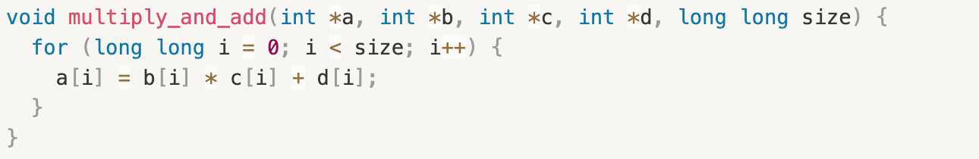
Vectorize Loop with Intel Intrinsics
Original

Slide 18
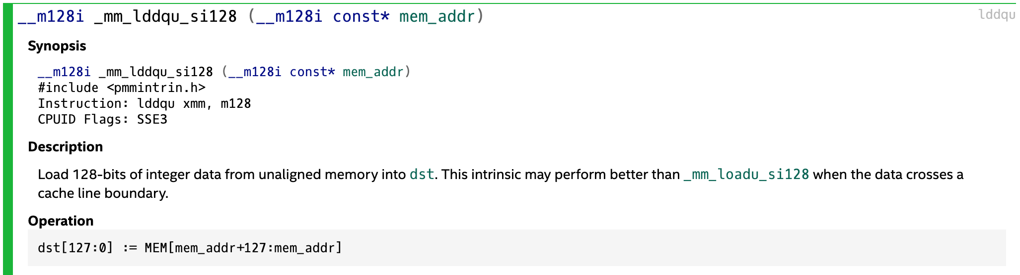
Vectorize Loop with Intel Intrinsics
Check CPU support
Up to SSE4.2, no FMA (on apollo)
Load data from memory to the special registers
Use 128-bit instruction set & integer ⇒ __m128i
Load data (check Intel Intrinsics Guide) ⇒ _mm_lddqu_si128

Slide 19
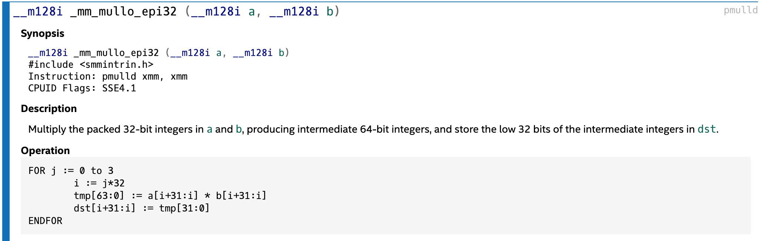
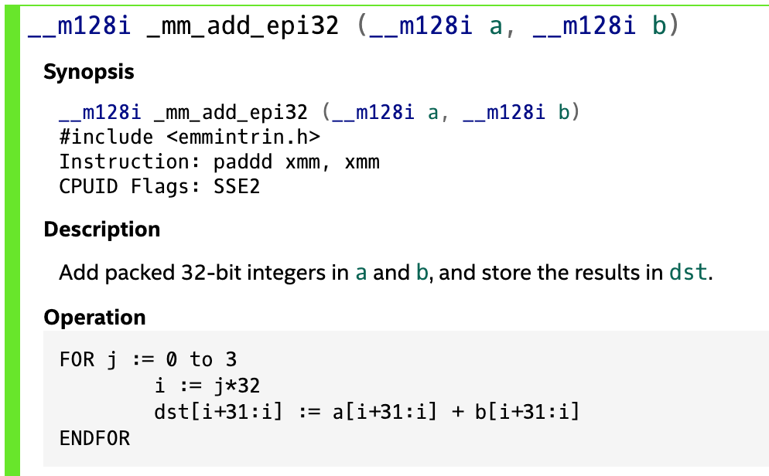
Vectorize Loop with Intel Intrinsics
Perform vector instructions
No FMA ⇒ cannot do multiplication and addition in 1 instruction
Perform multiplication first, then addition

Slide 20
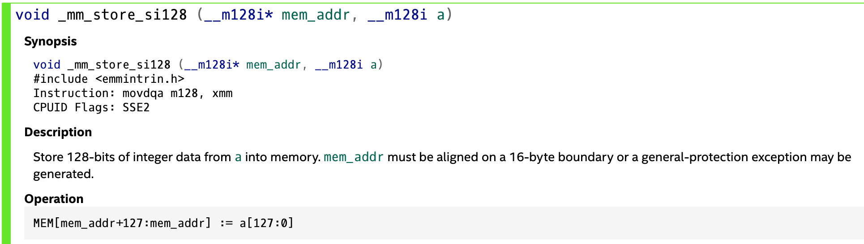
Vectorize Loop with Intel Intrinsics
Save data from the special registers to memory

Slide 21
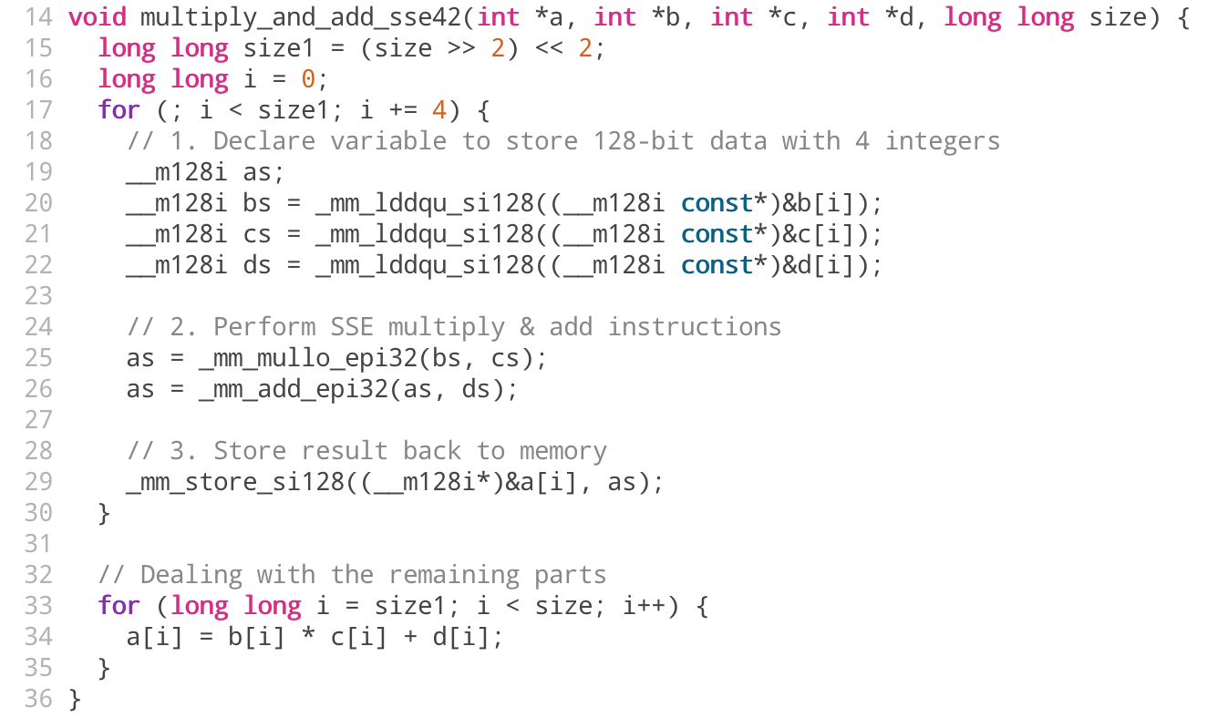
Promise the vectorized loop is aligned to 128 bits
Dealing with the remaining data

Slide 22
Hint
Theoretically, use SIMD instruction can improve performance
With SSE instruction, it could be about 2x~8x faster
SSE~AVX2 intrinsics is supported by gcc, but only Intel Compiler supports AVX512 intrinsics
Try it by yourself!!!
Take advantage of auto-vectorization
You can use any intrinsics in your homework

